Slide 1
Kodiak West Travel
Your Travel
Your Way

Slide 2
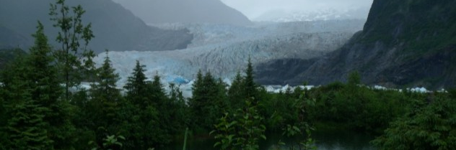
Your Dreams
Whether you want to trek on a glacier or spend your time in quiet solitude, Kodiak West Travel can make your dream a reality.
Notes:
If you can dream it, we can help you get there.

Slide 3
Our Expertise
Over 20 years of experience in the travel industry
Certified Travel Associates
Specializing in land and sea travel
Pacific Northwest including U. S. and Canada
Notes:
Kodiak West Travel has locations in Juneau, Anchorage, and Victoria.

Slide 4
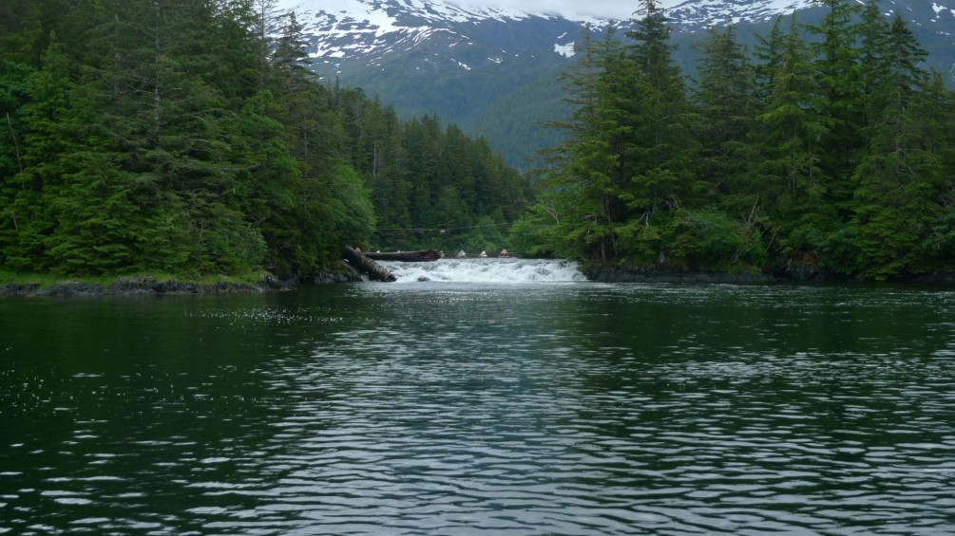
Your Vacation

Slide 5
About Our Company
Kodiak West Travel was established in May of 2001 by Ken Dakona and Mariam Dorner, two Alaska residents whose sense of adventure and commitment to ecotourism is an inherent aspect of their travel itineraries.

